Slide 1
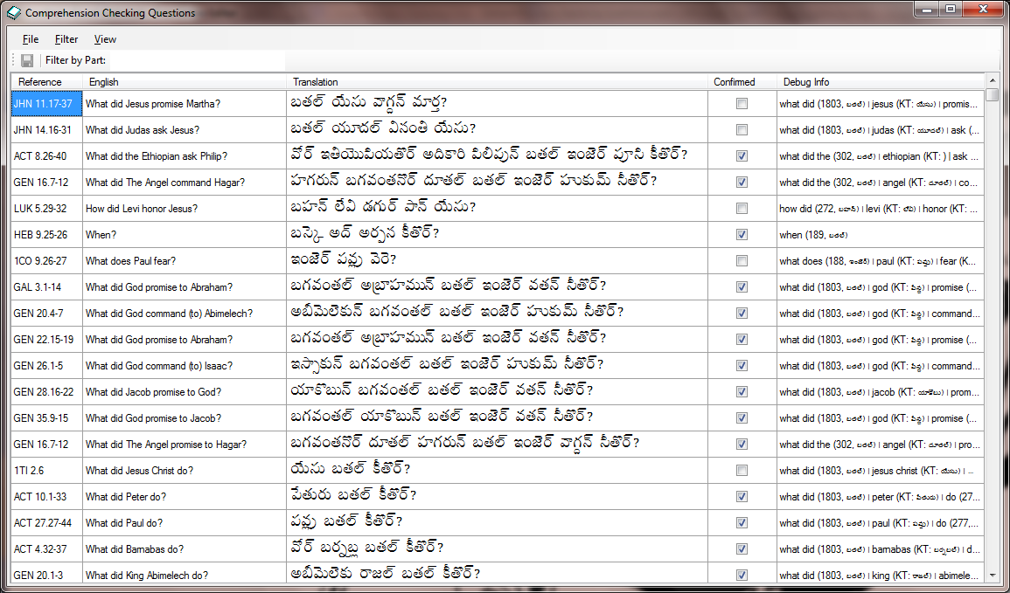
Comprehension Checking tool

Slide 2
What?
What did _________ do? (56)
What did ______ tell _____ to do? (39)
A tool to semi-automate translation of Comprehension Checking
Example Comprehension Checking Questions:
Briefly tell in your own words what the author said. (81)
What did Laban do? (2)
What did Jesus tell Mary to do? (1)
Leah
Andrew
Peter Jesus
God John
Notes:
Basically, this is a tool to semi-automate translation of Comprehension Checking. The premise is that as a user translates a few questions, it is possible to infer plausible translations or partial translations for many other similar questions (or questions with parts that are similar).
(click)
Mark Penny did the early pioneering on this. He noticed that canned list of comprehension checking questions in Translators Workplace had a lot of questions that were exact duplicates (for different Scripture passages), very similar, or contained phrases that were repeated in a lot of questions. (click) He figured out that he could have the MTTs translate a few questions and common phrases reuse those so they wouldn’t have to translate every question from scratch. (click) Furthermore, by taking advantage of his key terms database, he could get the computer to plug the correct names into questions that had a common frame (e.g., “What did A say to B?”). (click) When Mike Cochran was in India Mark showed him what he had come up with and asked if someone could take this concept and package it in a form that would make it accessible to teams that didn’t have a Mark Penny.
That’s how I got involved. Since I already had connections to India and needed an excuse to get away and try to get some fresh perspective, I volunteered to take my family and go off to India for a couple months to work on this. Before leaving, Tim and I did some work in the spring to put together a prototype (mostly using Spanish for our test language). The initial development was done in the context of Translation Editor, and the code is currently in FieldWorks’ Perforce repository, but it was intentionally designed to be able to be built independent of FW so it can be hooked up in Translation Editor, Paratext, or any Bible translation software that can supply key term renderings in the vernacular.

Slide 3
Who?
Primary target users are translators (MTTs and OWLs)
Notes:
The target user communities are basically the same people who would use TE and Paratext for drafting and/or checking Scripture translations.

Slide 4
How it fits in?
Preparation for the checking process.
In Translation Editor
Paratext soon?
Stand-alone
Future: could feed into process for eliciting feedback from the crowd via web- or mobile-based technologies.
Notes:
In terms of a typical translation project’s process, this tool is useful as part of the checking process for drafted Scripture. This checking is sometimes called UNS checking because it involves having an Uninitiated Native Speaker to test the translation for clarity and accuracy.
(click) As I said, it’s currently hooked up in TE because that’s what I knew best. An early version of it is available in FW7.1 if you want to play with it, but it’s going to be quite a bit better in 7.2
(click) We definitely designed this with the intention of making it able to be hooked up in Paratext. My understanding is that there is interest in doing that. Not sure of the timing.
(click) With a minimal effort, it could be built to run as a stand-along app, but to be very useful it would have to have access to key term renderings (either by direct file access or via an API).
(click) Currently its output is a Lectionary Control File, which can be processed using an obscure command in Paratext to mate it up with Scripture portions to produce an HTML document that can be printed or whatever to prepare for UNS checking. Mark has asked me to add the ability in TE to do this so that an MTT could produce usable output directly. (Still need to decide if this makes sense in light of our corporate direction.)
This week, some interesting conversations (mostly between John Hatton and Bob Eaton) have started. The thought is that these comprehension checking questions really ought to feed into a web- or mobile-based solution so that we could take advantage of the crowd.

Slide 5
Major Features So Far
User can enter translations and have similar questions get automatic (partial) translations
Saving and loading translations
Filter questions by book, matching text, and whether or not key terms have vernacular equivalents
Notes:
The main effort Tim and I put in during the spring was to get some basic UI so users could enter translations and do a proof of concept on the ability to generate usable translations for other questions. We have extensive unit tests for this. Initially, we just started from scratch every time we ran the tool, but that got old pretty quickly, so we added the ability to save and load the data. Also to make it easier to test specific behaviors, we added some basic filtering options. That’s basically what I took to India. Since we used Spanish as our test language (and even that produced mixed results), we really expected Mark to poke a lot of holes in our automated translation logic. We did find at least one major issue involving the way case is marked on proper names in most Indic languages, but I was pleasantly surprised that Mark thought it was good enough that he was more interested in having me polish some of the rough edges and work on getting usable output than on improving the logic. Some of those improvements still need to be done, but I think the early results are very promising.

Slide 6
Decisions, decisions…
When to incorporate it into Paratext?
Should TE be made to produce usable output without Paratext?
Should this be developed as a separate project or as part of some other product?
Should it have a name?

